Slide 1
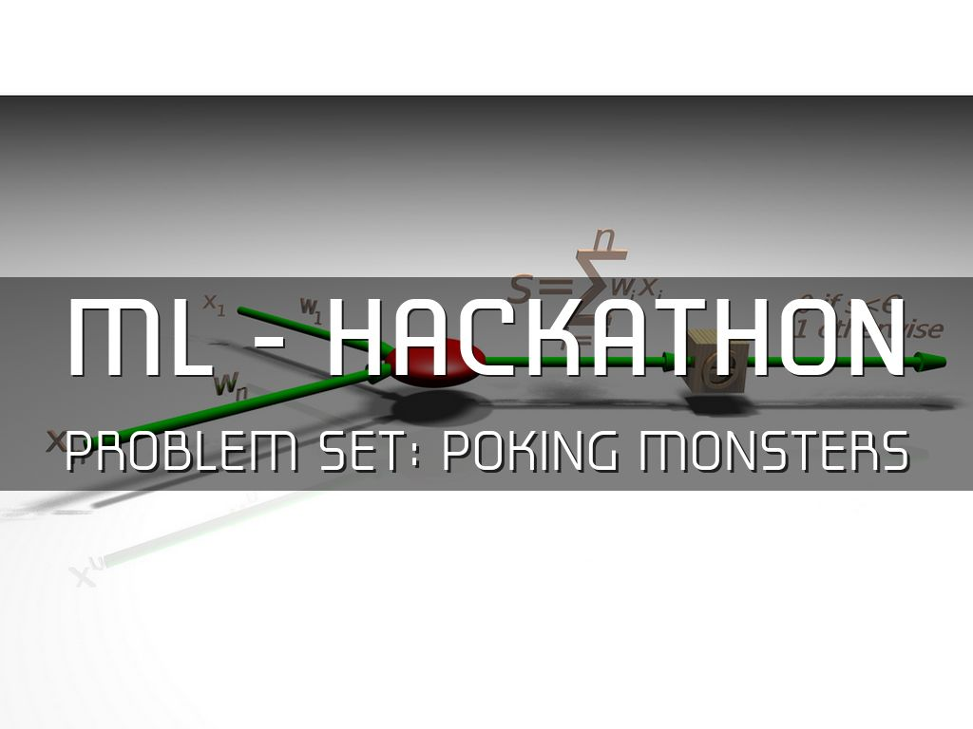
Photo by fdecomite - Creative Commons Attribution License https://www.flickr.com/photos/21649179@N00
Created with Haiku Deck

Slide 2
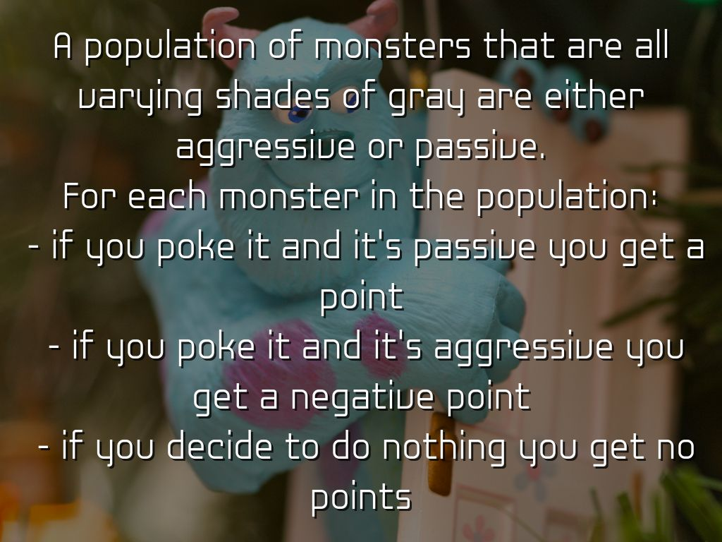
Photo by kevin dooley - Creative Commons Attribution License https://www.flickr.com/photos/12836528@N00
Created with Haiku Deck

Slide 3
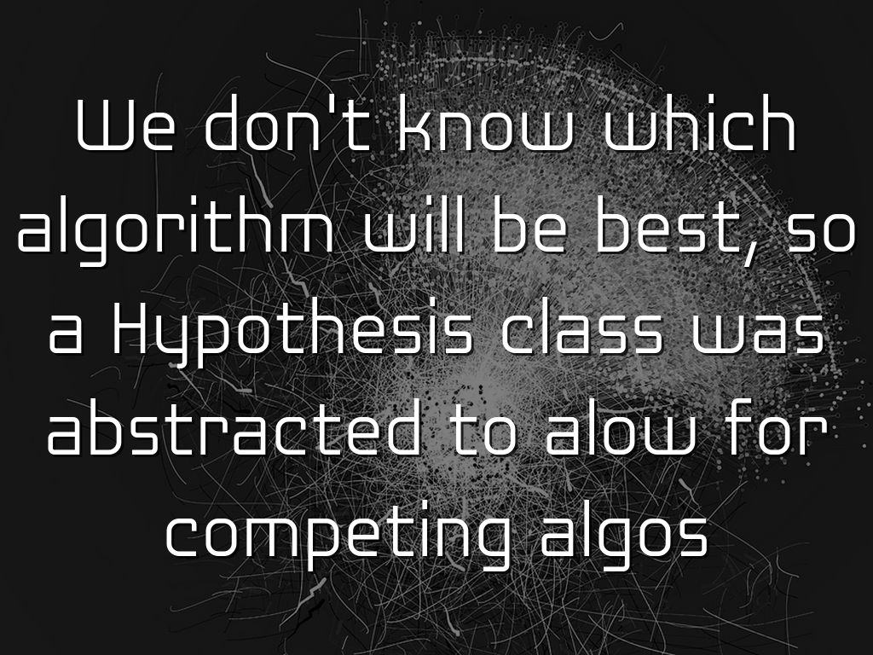
Photo by jm_escalante - Creative Commons Attribution-NonCommercial-ShareAlike License https://www.flickr.com/photos/27559155@N00
Created with Haiku Deck

Slide 4
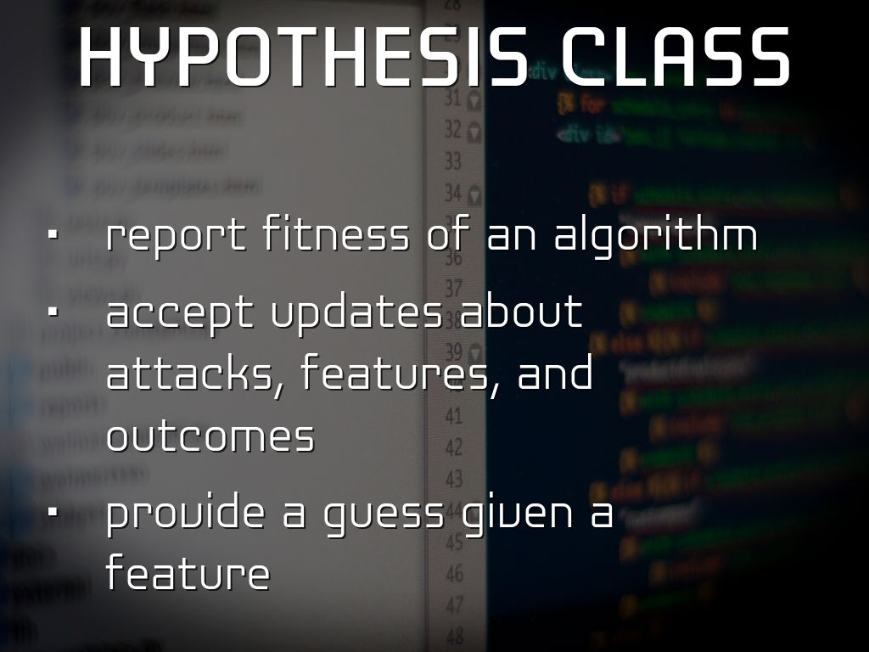
Photo by atxryan - Creative Commons Attribution-NonCommercial-ShareAlike License https://www.flickr.com/photos/57134288@N00
Created with Haiku Deck

Slide 5
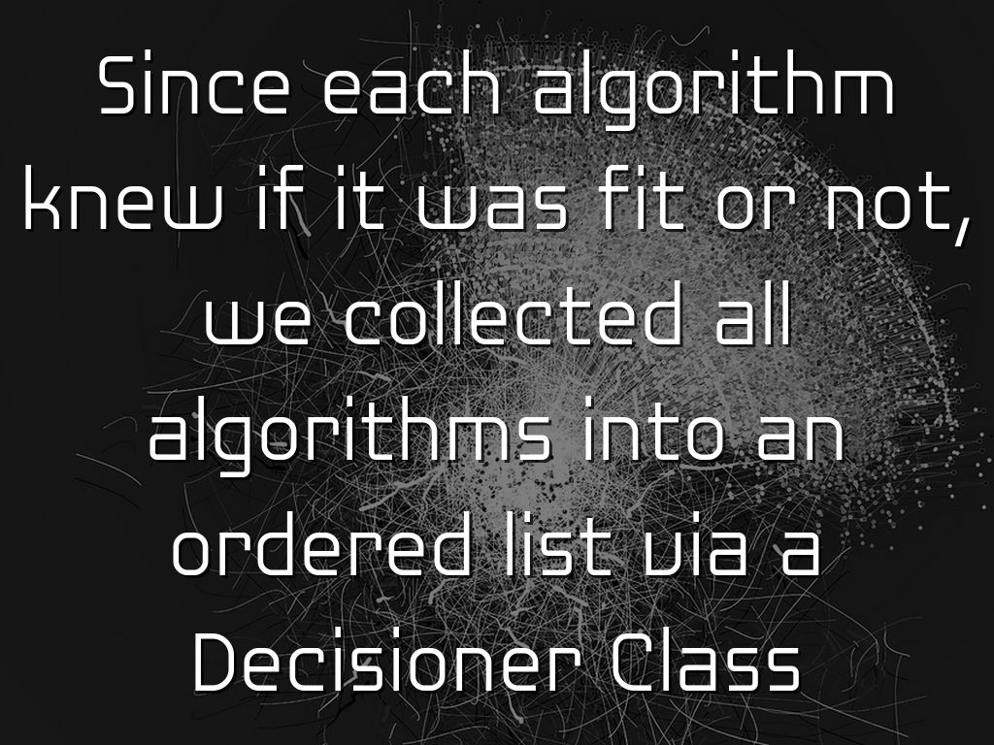
Photo by jm_escalante - Creative Commons Attribution-NonCommercial-ShareAlike License https://www.flickr.com/photos/27559155@N00
Created with Haiku Deck

Slide 6
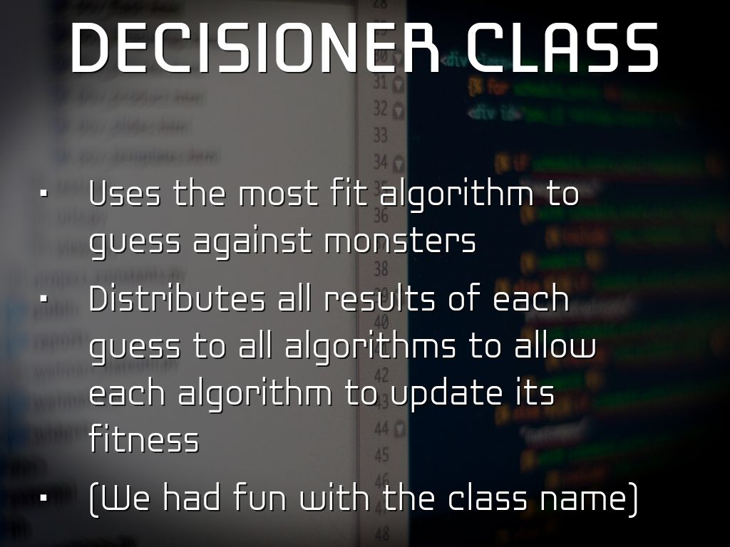
Photo by atxryan - Creative Commons Attribution-NonCommercial-ShareAlike License https://www.flickr.com/photos/57134288@N00
Created with Haiku Deck

Slide 7
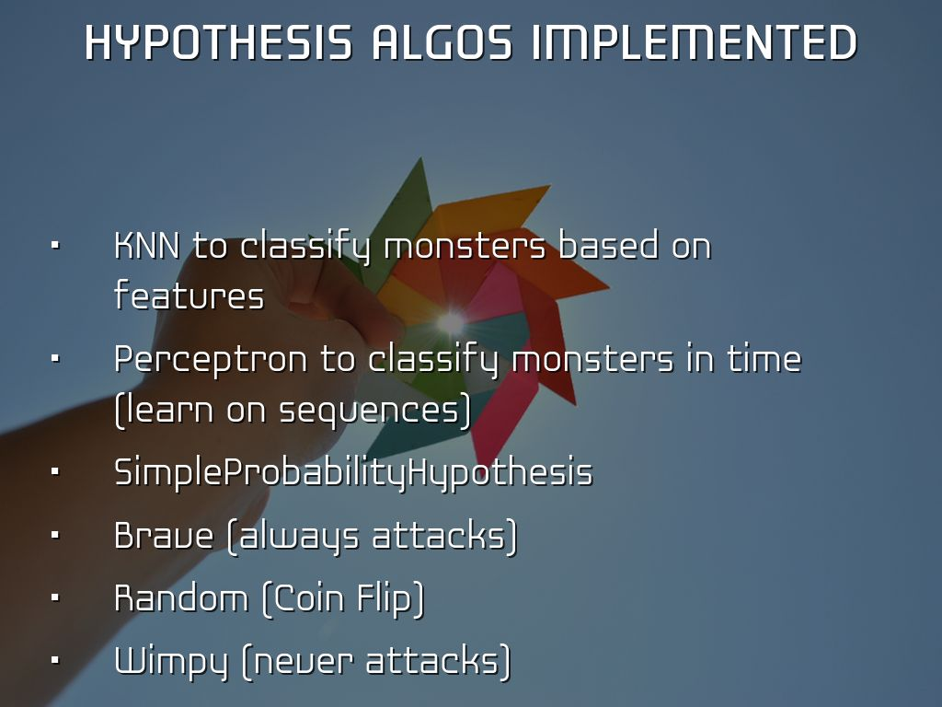
Photo by Ashley Campbell Photography - Creative Commons Attribution License https://www.flickr.com/photos/45916771@N03
Created with Haiku Deck

Slide 8
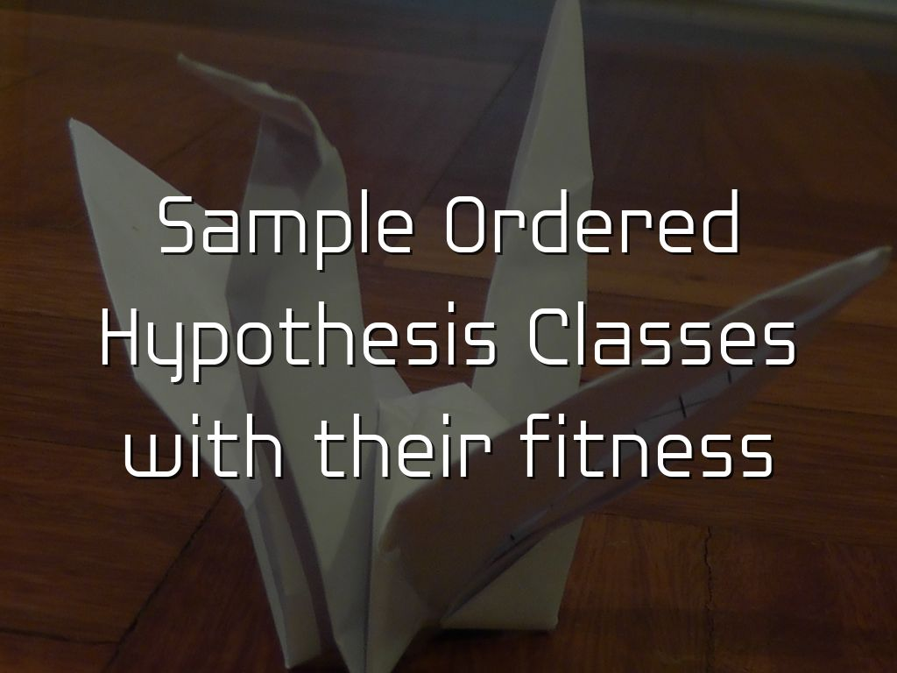
Photo by nist6ss - Creative Commons Attribution-ShareAlike License https://www.flickr.com/photos/53771866@N05
Created with Haiku Deck

Slide 9
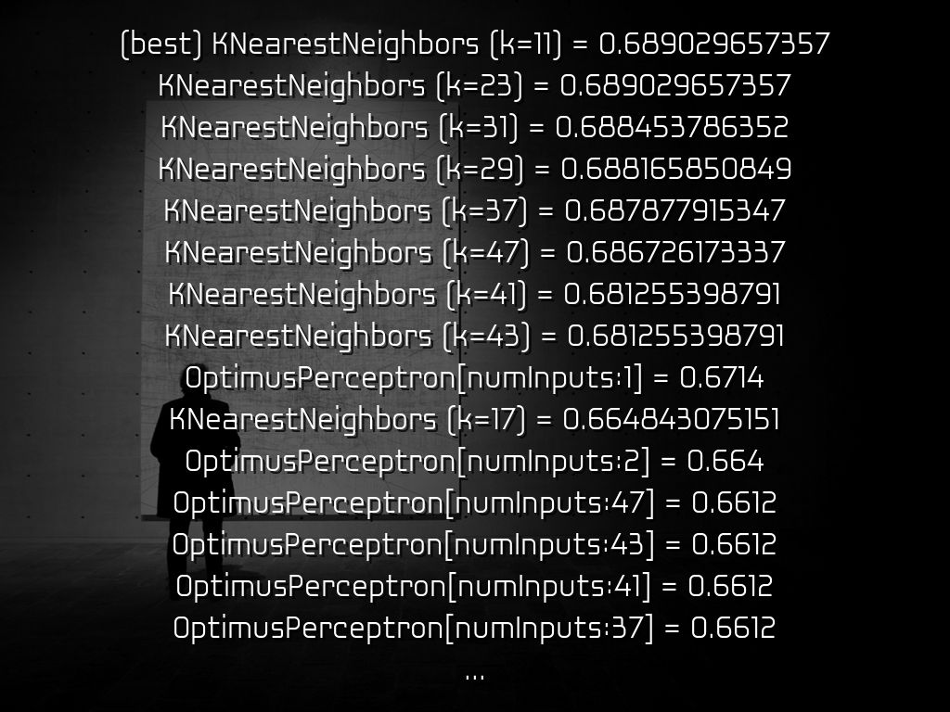
Photo by jrmllvr - Creative Commons Attribution License https://www.flickr.com/photos/70117145@N05
Created with Haiku Deck

Slide 10
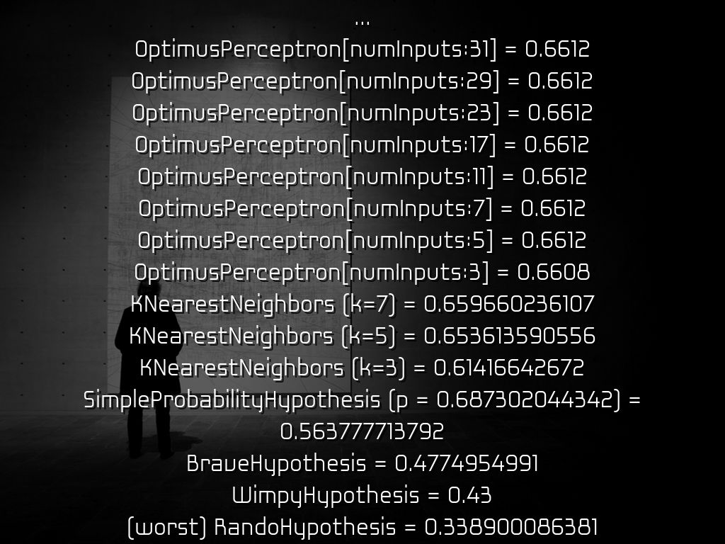
Photo by jrmllvr - Creative Commons Attribution License https://www.flickr.com/photos/70117145@N05
Created with Haiku Deck

Slide 11
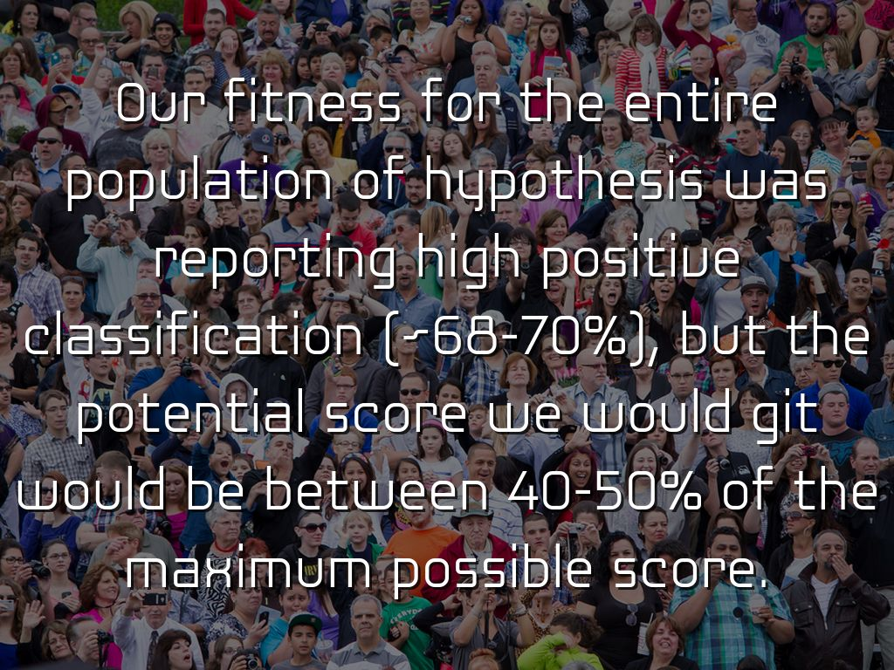
Photo by FromSandToGlass - Creative Commons Attribution License https://www.flickr.com/photos/22929260@N06
Created with Haiku Deck

Slide 12
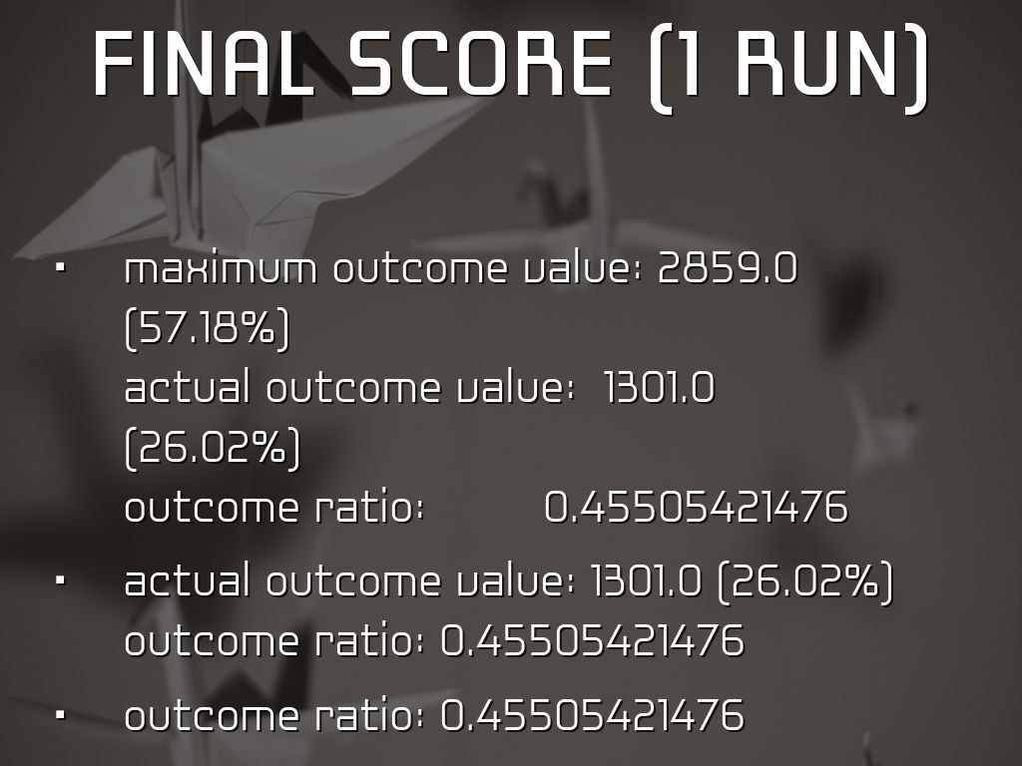
Photo by Andy.Schultz - Creative Commons Attribution-NonCommercial-ShareAlike License https://www.flickr.com/photos/63262340@N00
Created with Haiku Deck

Slide 13
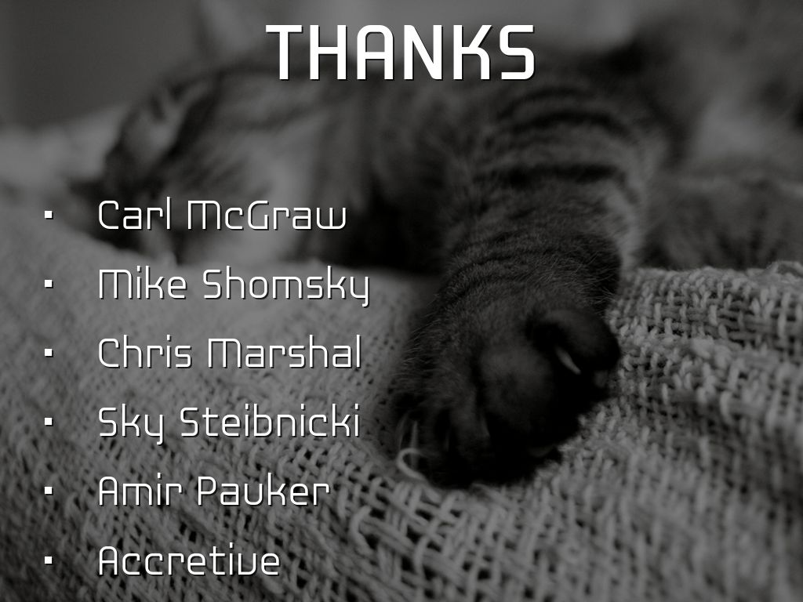
Photo by kevin dooley - Creative Commons Attribution License https://www.flickr.com/photos/12836528@N00
Created with Haiku Deck

Slide 14

Photo by Stuck in Customs - Creative Commons Attribution-NonCommercial-ShareAlike License https://www.flickr.com/photos/95572727@N00
Created with Haiku Deck
Notes:
7.) ====================================== Mike Analysis =============
@analysis for cardinality :5000
: k(Zeros)= 1527
: k(Ones)= 2387
: k(NegOne)= 1086
score hits on this many monsters : 1301 AND dodged this many monsters: 1527
Total aggressives: 2141.0 (% of total : 42.82)
misclassified aggressives: abs(guessed aggro - total aggro) / total aggro =0.622139187296
positively classified aggressives: 1- (abs(guessed aggro - total aggro) / total aggro) =0.377860812704
Total passives: 2859.0 (% of total : 57.18)
misclassified passives: abs(guessed passive - total passive) / total passive =0.465897166842
positively classified passives: 1-(abs(guessed passive - total passive) / total passive) =0.534102833158
score : 1301
max potential score (assume no aggressive): 2859.0
success ratio: score/max score = 0.45505421476
successful classification mean: (classified aggressives + classified passives)/2 = 0.455981822931
failure classification mean: (misclassified aggressives + misclassified passives)/2 = 0.544018177069
Final hypothesis fitness = 0.689029657357
8.) ====================================== Carl Analysis =============
Total aggressives: 2141.0 (0.4282)
Total passives: 2859.0 (0.5718)
Guessed aggressives: 3473.0 (0.6946)
Guessed passives: 1527.0 (0.3054)
guessed aggro - total aggro = 1332.0 missed points
guessed_passive - total passive = -1332.0 miscategorized passive
Total passive - Agressives we lost points to(1332.0) = Score:1527.0
We incorrectly categorized 1332.0 passives as aggressive (0.2664)
Total categorized correctly: 3668.0 (0.7336)
Final hypothesis fitness: 0.689029657357
ratio of total passive to number monsters : 0.5718
maximum outcome value: 2859.0 (0.5718)
actual outcome value: 1301.0 (0.2602)
outcome ratio: 0.45505421476
SCORE: 1301.0

Slide 15

Photo by tsmall - Creative Commons Attribution-ShareAlike License https://www.flickr.com/photos/61174949@N00
Created with Haiku Deck

